Slide 1

ON ROBOTS, TRUST AND BIAS
Chinonyerem Ukaegbu

Slide 2

outline
Notes:
We’ve got robots as the overarching theme and then we look at that through the lens of trust and then bias.

Slide 3
trust
“Robots—whether on the road, such as in the case of self-driving cars, or working in buildings, such as in the case of emergency evacuation robots—are influencing human decision making processes. Yet whether placing trust in the technology is warranted, especially when it can mean life or death, is an open question”
-Ayanna Howard, Jason Borenstein
Notes:
In their seminal work on trust in automation, John Lee and Katrina See (2004) defined trust “as the attitude that an agent will help achieve an individual’s goals in a situation characterized by uncertainty and vulnerability”

Slide 4
on one hand,
There is a tendency to overtrust robotic systems, primarily because of the tendency to rely on computing devices and their ‘wealth of knowledge’
on the other,
There is the lack of trust in robotic systems, perhaps due to media and popular culture or not fully understanding how they work
Notes:
Something we’ll end up finding out is that trust depends heavily on context
Example of search results where they reversed the search results and then the users still picked the first two and when they were asked what they thought of the results, they said oh maybe they had typed in the queries wrongly, i.e. internalizing the blame

Slide 5
experiment investigating trust toward robots and AI in an online trust game
o Participants (N = 1077) lived in the United States.
o Describing opponents with robots or AI did not impact participants’ trust toward them. The robot called jdrx894 was the most trusted opponent. Opponents named “jdrx894” were trusted more than opponents called “Michael.”
o Further analysis showed that having a degree in technology or engineering, exposure to robots online and robot use self-efficacy predicted higher trust toward robots and AI.
o Out of Big Five personality characteristics, openness to experience predicted higher trust, and conscientiousness predicted lower trust.
o Results suggest trust on robots and AI is contextual and it is also dependent on individual differences and knowledge on technology.
Notes:
Conscientiousness - personality trait of being careful or diligent

Slide 6
observations on trust
There is a current need for studies investigating trust toward AI and robots, especially in first-encounter situations involving little information about the other actor.
Existing literature shows that humans are more willing to accept new technologies, such as robots, when they have prior experience and self-efficacy in handling them.
Trust always has a social and operational context or environment. How much people trust technology, such as robots and AI, depends on where they are used. For example, people may consider service robots in hospitals trustworthy if they trust hospitals in general.
Notes:
What could this be useful for?
Self-efficacy - an individual's belief in his or her capacity to execute behaviours necessary to produce specific performance attainments (Bandura, 1977, 1986, 1997).

Slide 7
bias
“What the eye doesn’t see and the mind doesn’t know, doesn’t exist.”
-D.H. Lawrence

Slide 8
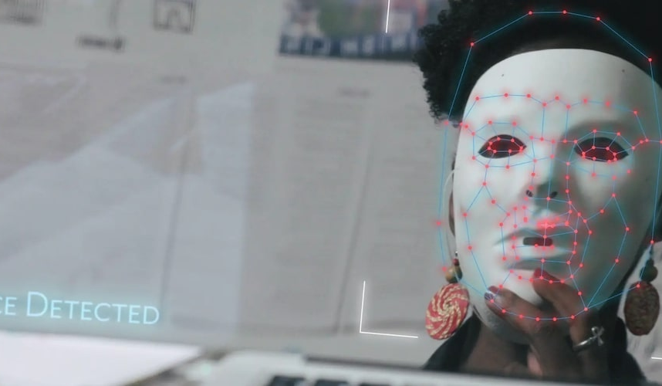
Bias involves the disposition to allow our thoughts and behaviours, often implicitly or subconsciously, to be affected by our generalizations or stereotypes about others.
AI bias often begins with people, counter to the popular narrative that we’ll soon be controlled by AI robot overlords
Notes:
MIT media researcher Joy Buolamwini's computer science studies uncovered that her face was unrecognizable in many facial recognition programs and she was motivated to find out why. She gains momentum in her research when she realized that facial recognition programs didn't work on her own face, but worked when she wore a white mask. This shocking discovery only made her more intrigued about how else artificial technology was affecting minorities.

Slide 9
Amazon Recruiting Tool
Pedestrian Detection
COMPAS
real-world instances of bias
predicted twice as many false positives for recidivism for black offenders (45%) than white offenders (23%)
found that eight such systems were worse at recognizing people with darker skin tones than paler ones
penalized résumés that included the word “women’s” and downgraded graduates of two all-women’s colleges
Notes:
Arguably the most notable example of AI bias is the COMPAS (Correctional Offender Management Profiling for Alternative Sanctions) algorithm used in US court systems to predict the likelihood that a defendant would become a recidivist (a convicted criminal who reoffends, especially repeatedly). Due to the data that was used, the model that was chosen, and the process of creating the algorithm overall, the model predicted twice as many false positives for recidivism for black offenders (45%) than white offenders (23%).
The reason for that was because the algorithm was based on the number of resumes submitted over the past ten years, and since most of the applicants were men, it was trained to favor men over women.

Slide 10
explainable ai
One promising strategy for mitigating overtrust and bias is “explainable AI,” in which there would be some level of transparency about how AI makes a decision.
what could be a potential issue with this?
Hint: think of when the decision may be explained
Notes:
But then how do you as a designer create explainable AI when we don’t fully understand how AI works

Slide 11
why does this matter?
Many entities, including government agencies, are talking about placing profound trust in computing technology. Yet biases built into the technology have a propensity to shape perceptions of the truth.
Bias is often very subtle and most times, isn’t predicted. This means by the time bias is detected, it has already had an effect on a group of people

Slide 12
questions
“Robot researchers are typically educated to solve difficult technical problems, not to consider societal questions about who gets to make robots or how the machines affect society”
What do you believe should be the responsibilities of robot researchers?
Should we keep robots and robot technology away from sensitive fields (such as law enforcement) until we figure ourselves out. Follow up question: what are we willing to sacrifice for technological advancement.
One probable solution to algorithmic bias is to add specialized filters for different communities. Do you feel this is effective as it addresses the needs of specific communities, or do you believe it’s just another layer of bias.
We’ve focused on whether we can trust robots. Consider the other end of the stick, can robots trust humans? What reasons might they have to trust?
Will AI ever be unbiased? Follow up question: Is that what we want?
Can we turn things around and use AI to somehow reduce bias? How?
Notes:
4. Maybe robots don’t have the capacity to trust. We can rephrase the question then on whether or not we can trust the owners of the robot

Slide 13
conclusion

Slide 14
references
"...If Robots Can Be Biased?". California Science Center, 2020, https://californiasciencecenter.org/funlab/ever-wonder/2020-11-11/if-robots-can-be-biased.
Berreby, David. "Can We Make Our Robots Less Biased Than We Are? (Published 2020)". Nytimes.Com, 2020, https://www.nytimes.com/2020/11/22/science/artificial-intelligence-robots-racism-police.html.
Howard, Ayanna, and Jason Borenstein. "Trust And Bias In Robots". American Scientist, vol 107, no. 2, 2019, p. 86. Sigma Xi, https://doi.org/10.1511/2019.107.2.86. Accessed 26 Feb 2022.
Larkin, Zoe. "AI Bias - What Is It And How To Avoid It?". Levity.Ai, 2021, https://levity.ai/blog/ai-bias-how-to-avoid.
Lee, John D., and Katrina A. See. "Trust In Automation: Designing For Appropriate Reliance". Human Factors: The Journal Of The Human Factors And Ergonomics Society, vol 46, no. 1, 2004, pp. 50-80. SAGE Publications, https://doi.org/10.1518/hfes.46.1.50.30392. Accessed 26 Feb 2022.
Oksanen, Atte et al. "Trust Toward Robots And Artificial Intelligence: An Experimental Approach To Human–Technology Interactions Online". Frontiers In Psychology, vol 11, 2020. Frontiers Media SA, https://doi.org/10.3389/fpsyg.2020.568256. Accessed 26 Feb 2022.

Slide 15
THANKS
Do you have any questions?
Please keep this slide for attribution

